Slide 1

Demystifying MERN Stack

Slide 2


What is the MERN Stack?
MERN stands for MongoDB, Express, React, Node, after the four key technologies that make up the stack.
MongoDB - document database
Express - Node.js web framework
React - Client-side JavaScript framework
Node - The JavaScript web server

Slide 3
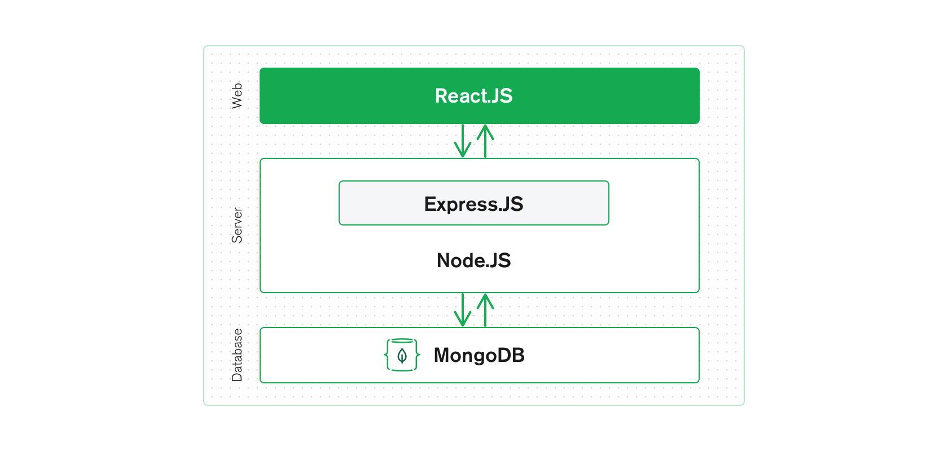
How does the MERN stack work?
The MERN architecture allows you to easily construct a 3-tier architecture (frontend, backend, database) entirely using JavaScript and JSON

Slide 4

Building Microservices with Node and ExpressJS

Slide 5
Why?
What?
Advantages
APIs vs Microservices
Microservices

Slide 6
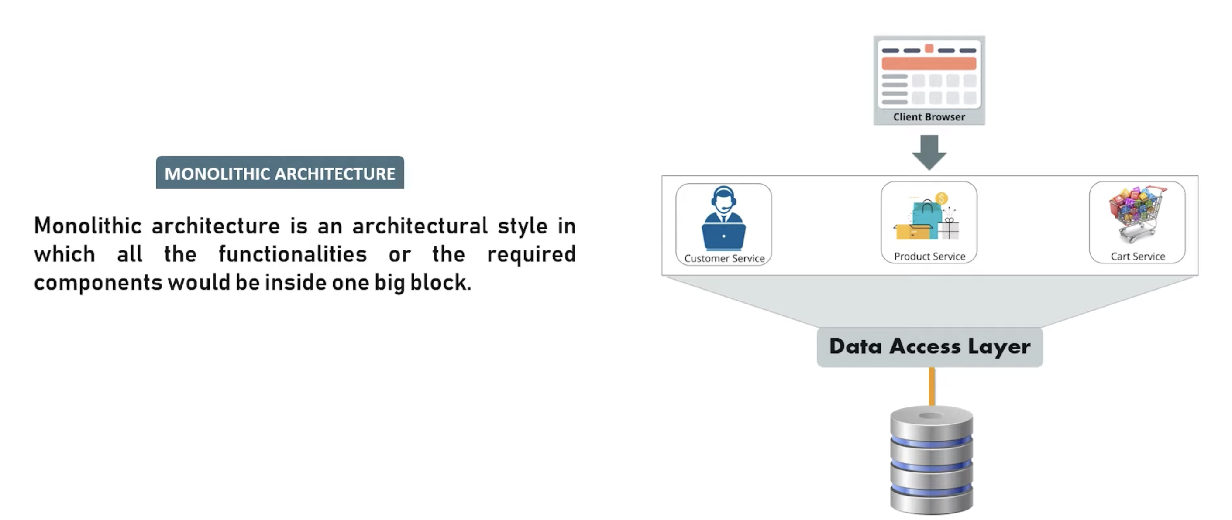
WHY? – Before Microservices

Slide 7
Monolith Architecture - Challenges
Large & Complex applications
Slow Development
Scalability Issues
Unreliable

Slide 8
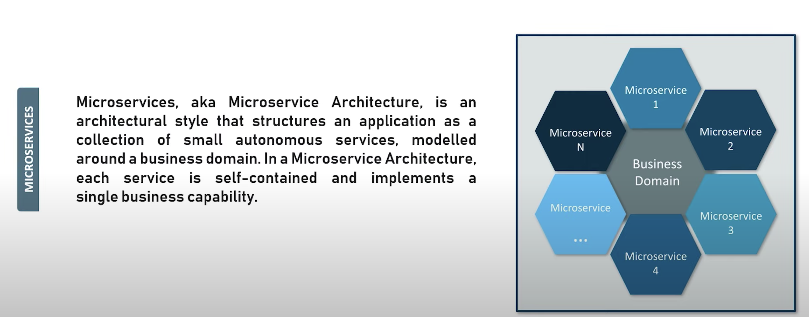
What are Microservices?

Slide 9
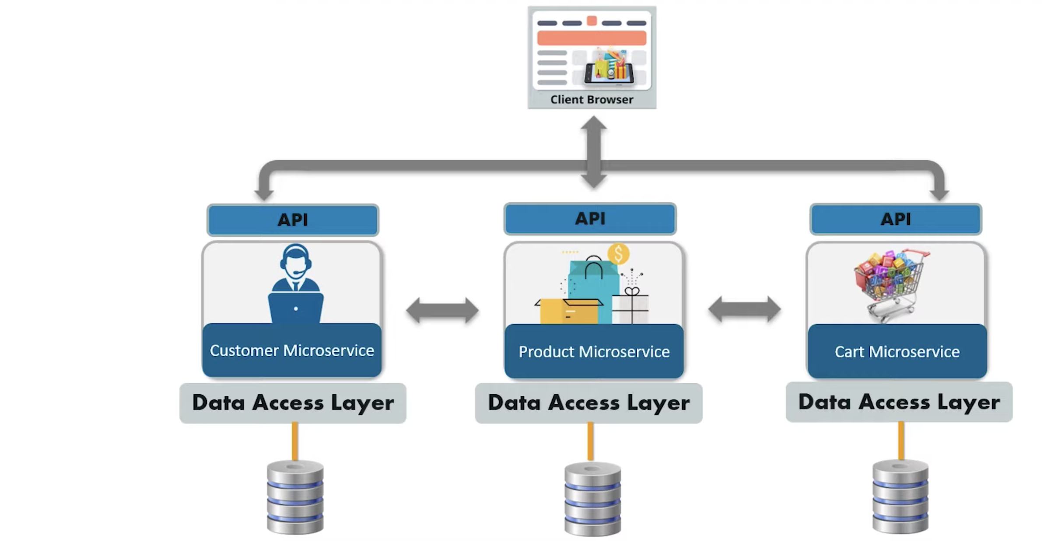
Microservices - Example

Slide 10
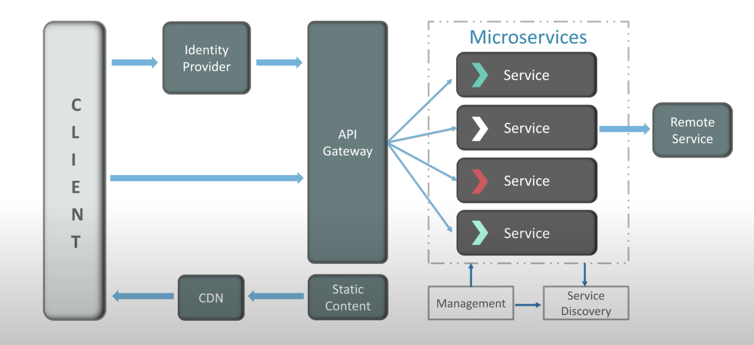
Microservice Architecture

Slide 11
Advantages
Loosely Coupled
Language Neutral
Bounded Context
Independent Development
Fault Isolation

Slide 12
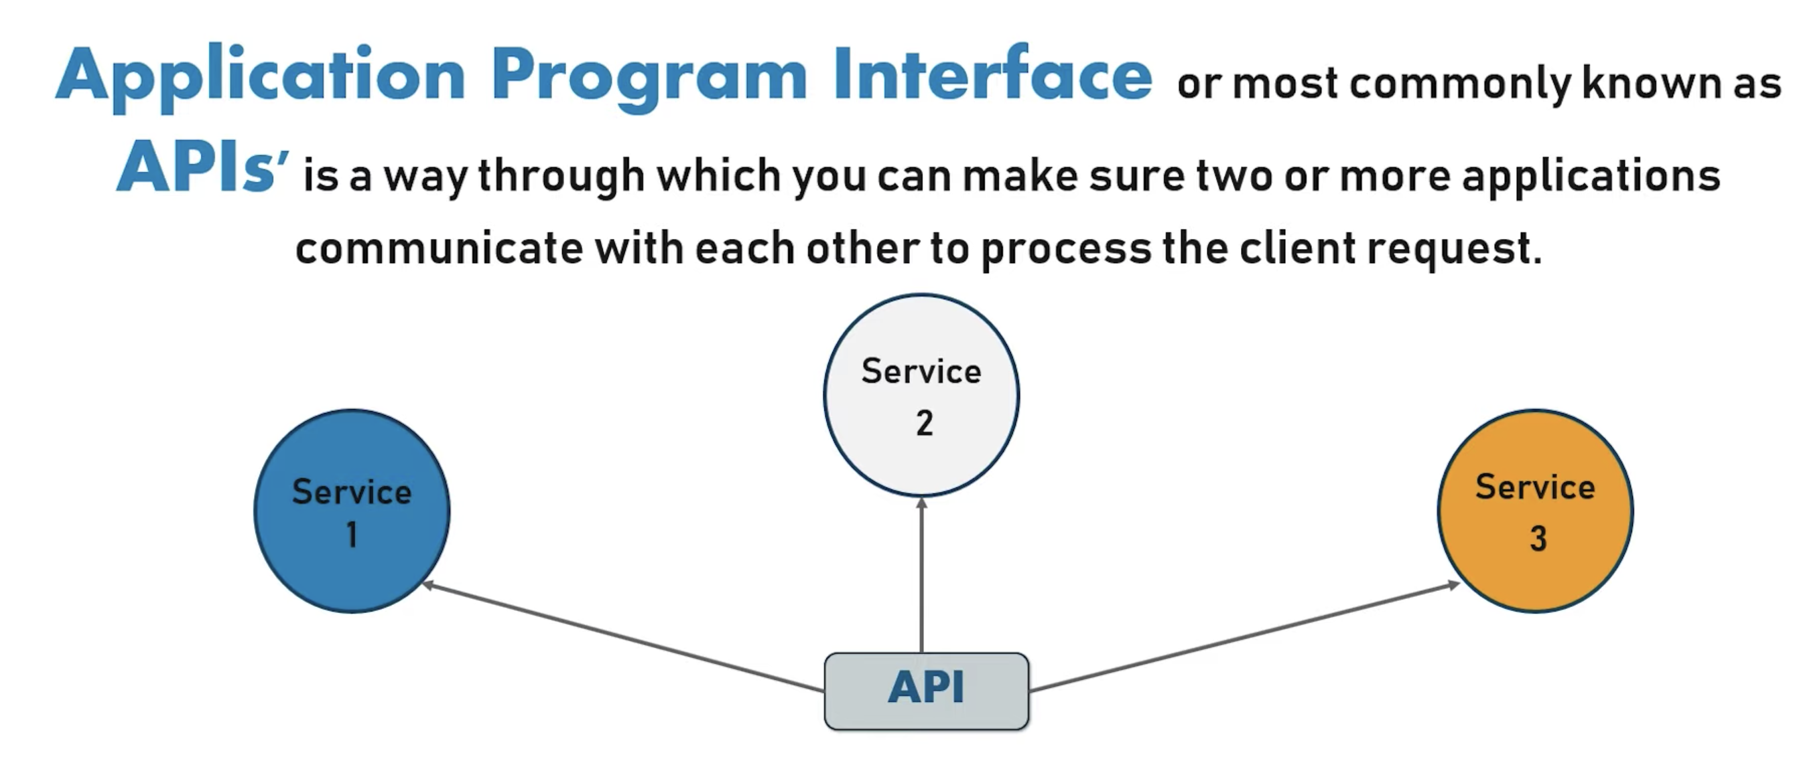
APIs

Slide 13
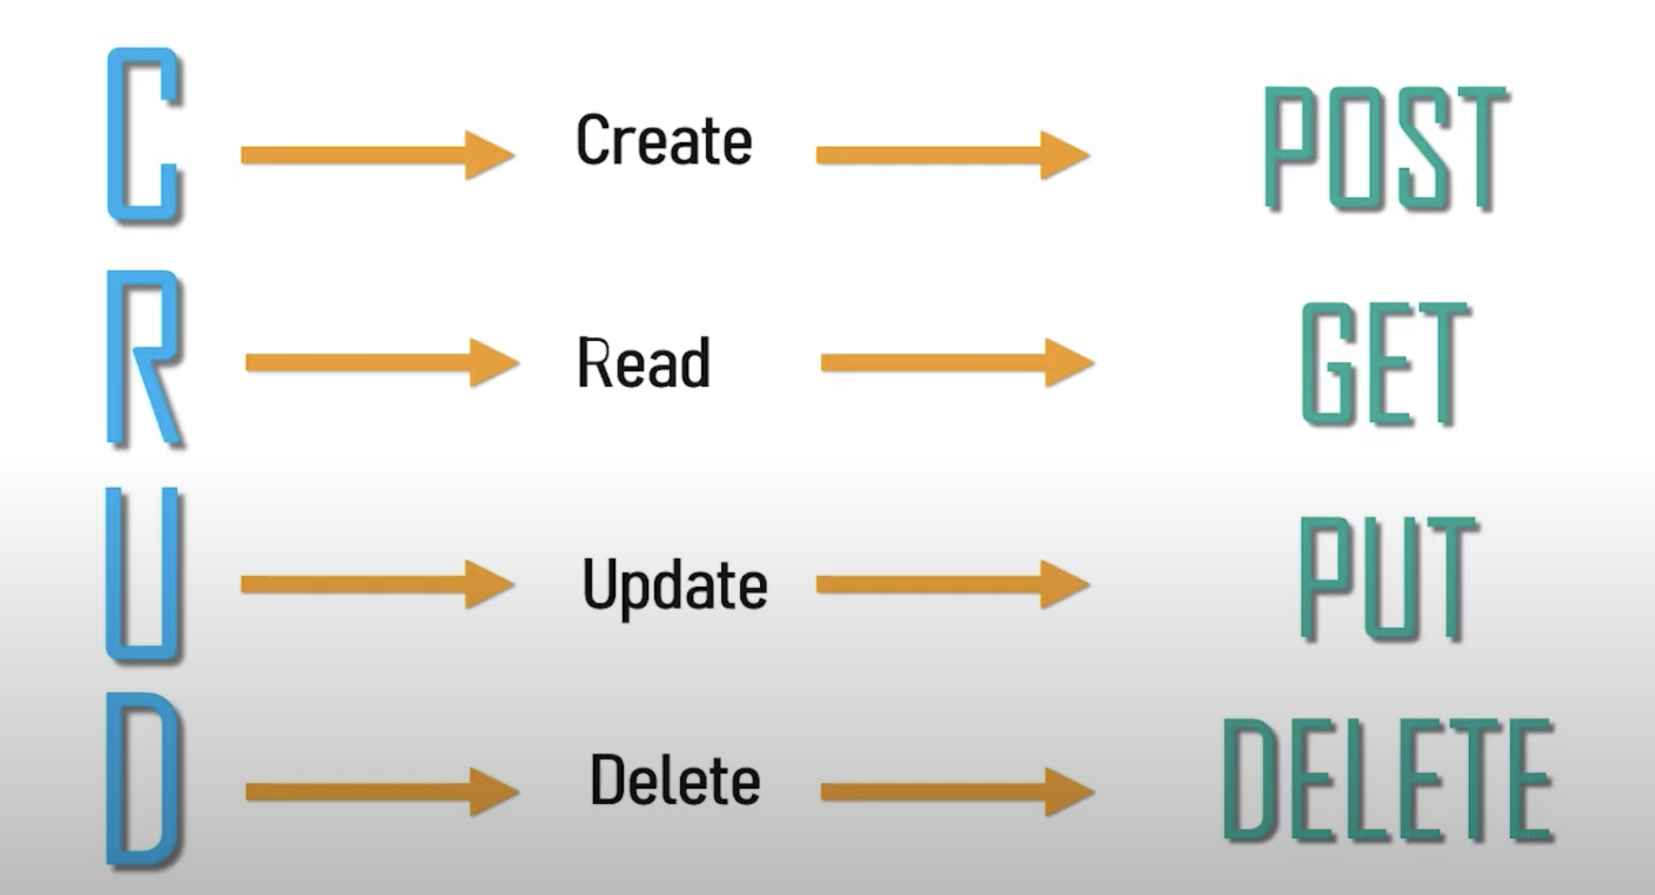
HTTP METHODS

Slide 14
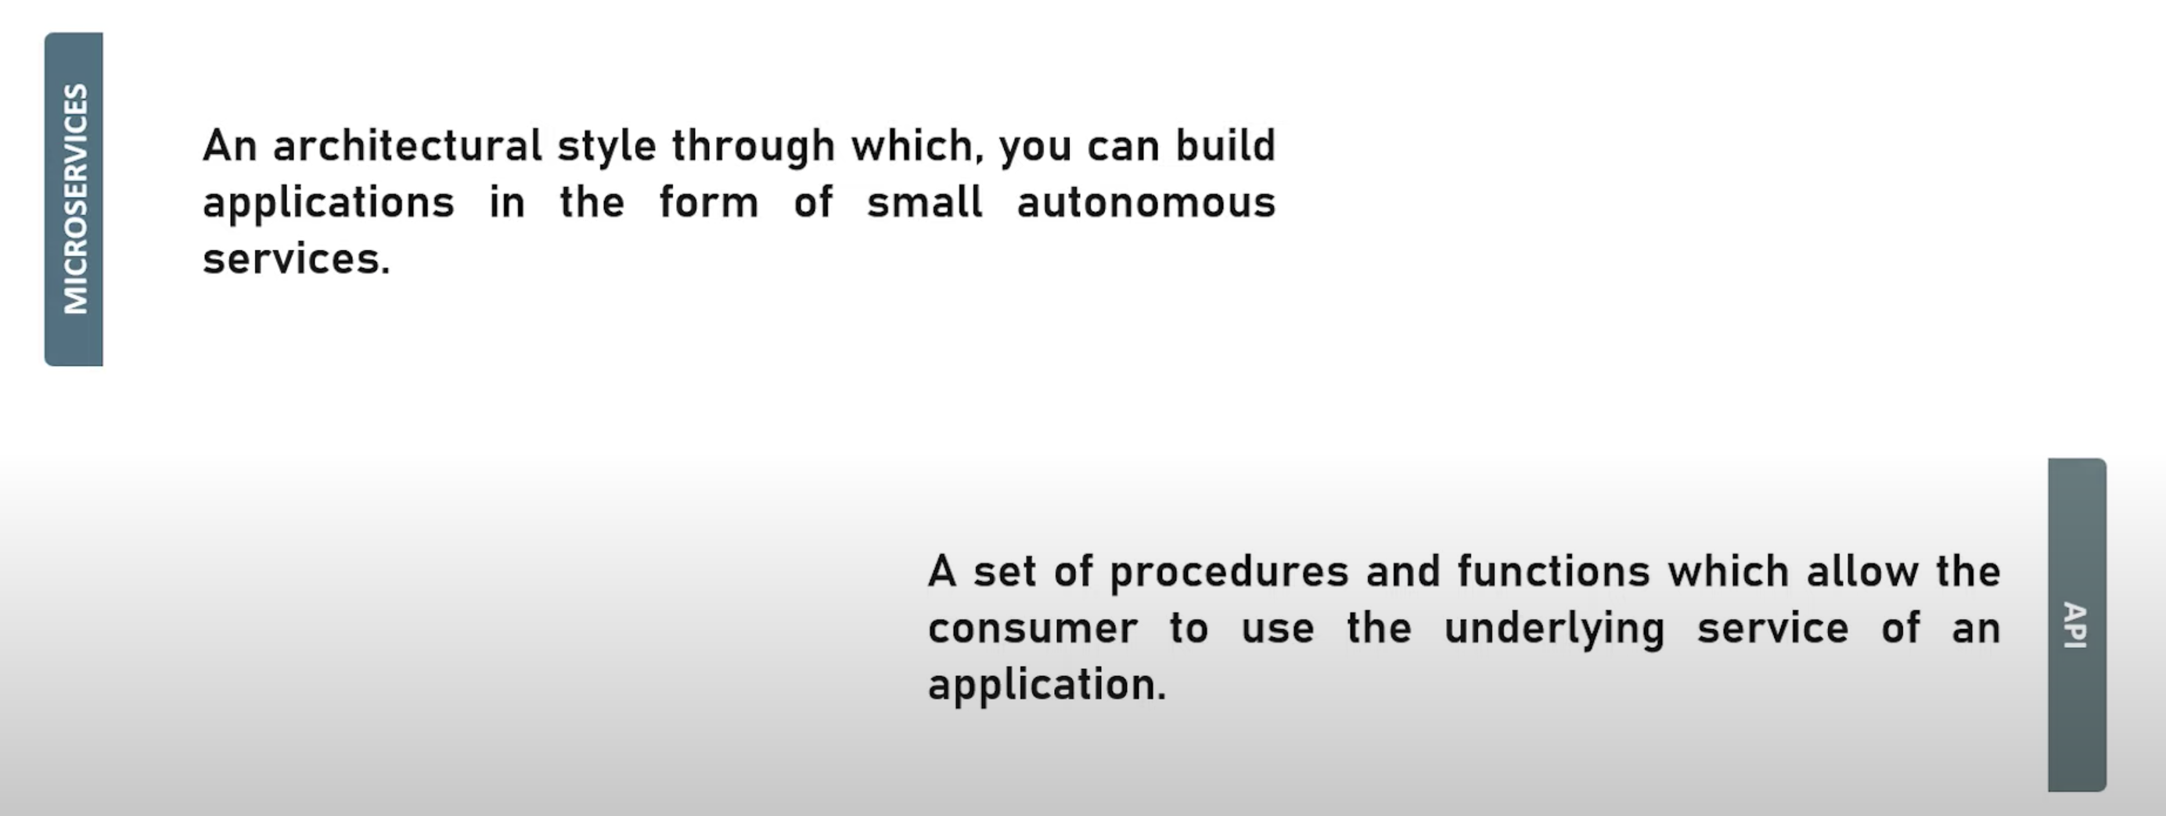
APIs vs Microservices

Slide 15
NodeJS
Runtime environment for JavaScript using V8 Engine
Asynchronous Event-Driven
Non-Blocking I/O
Single Threaded

Slide 16
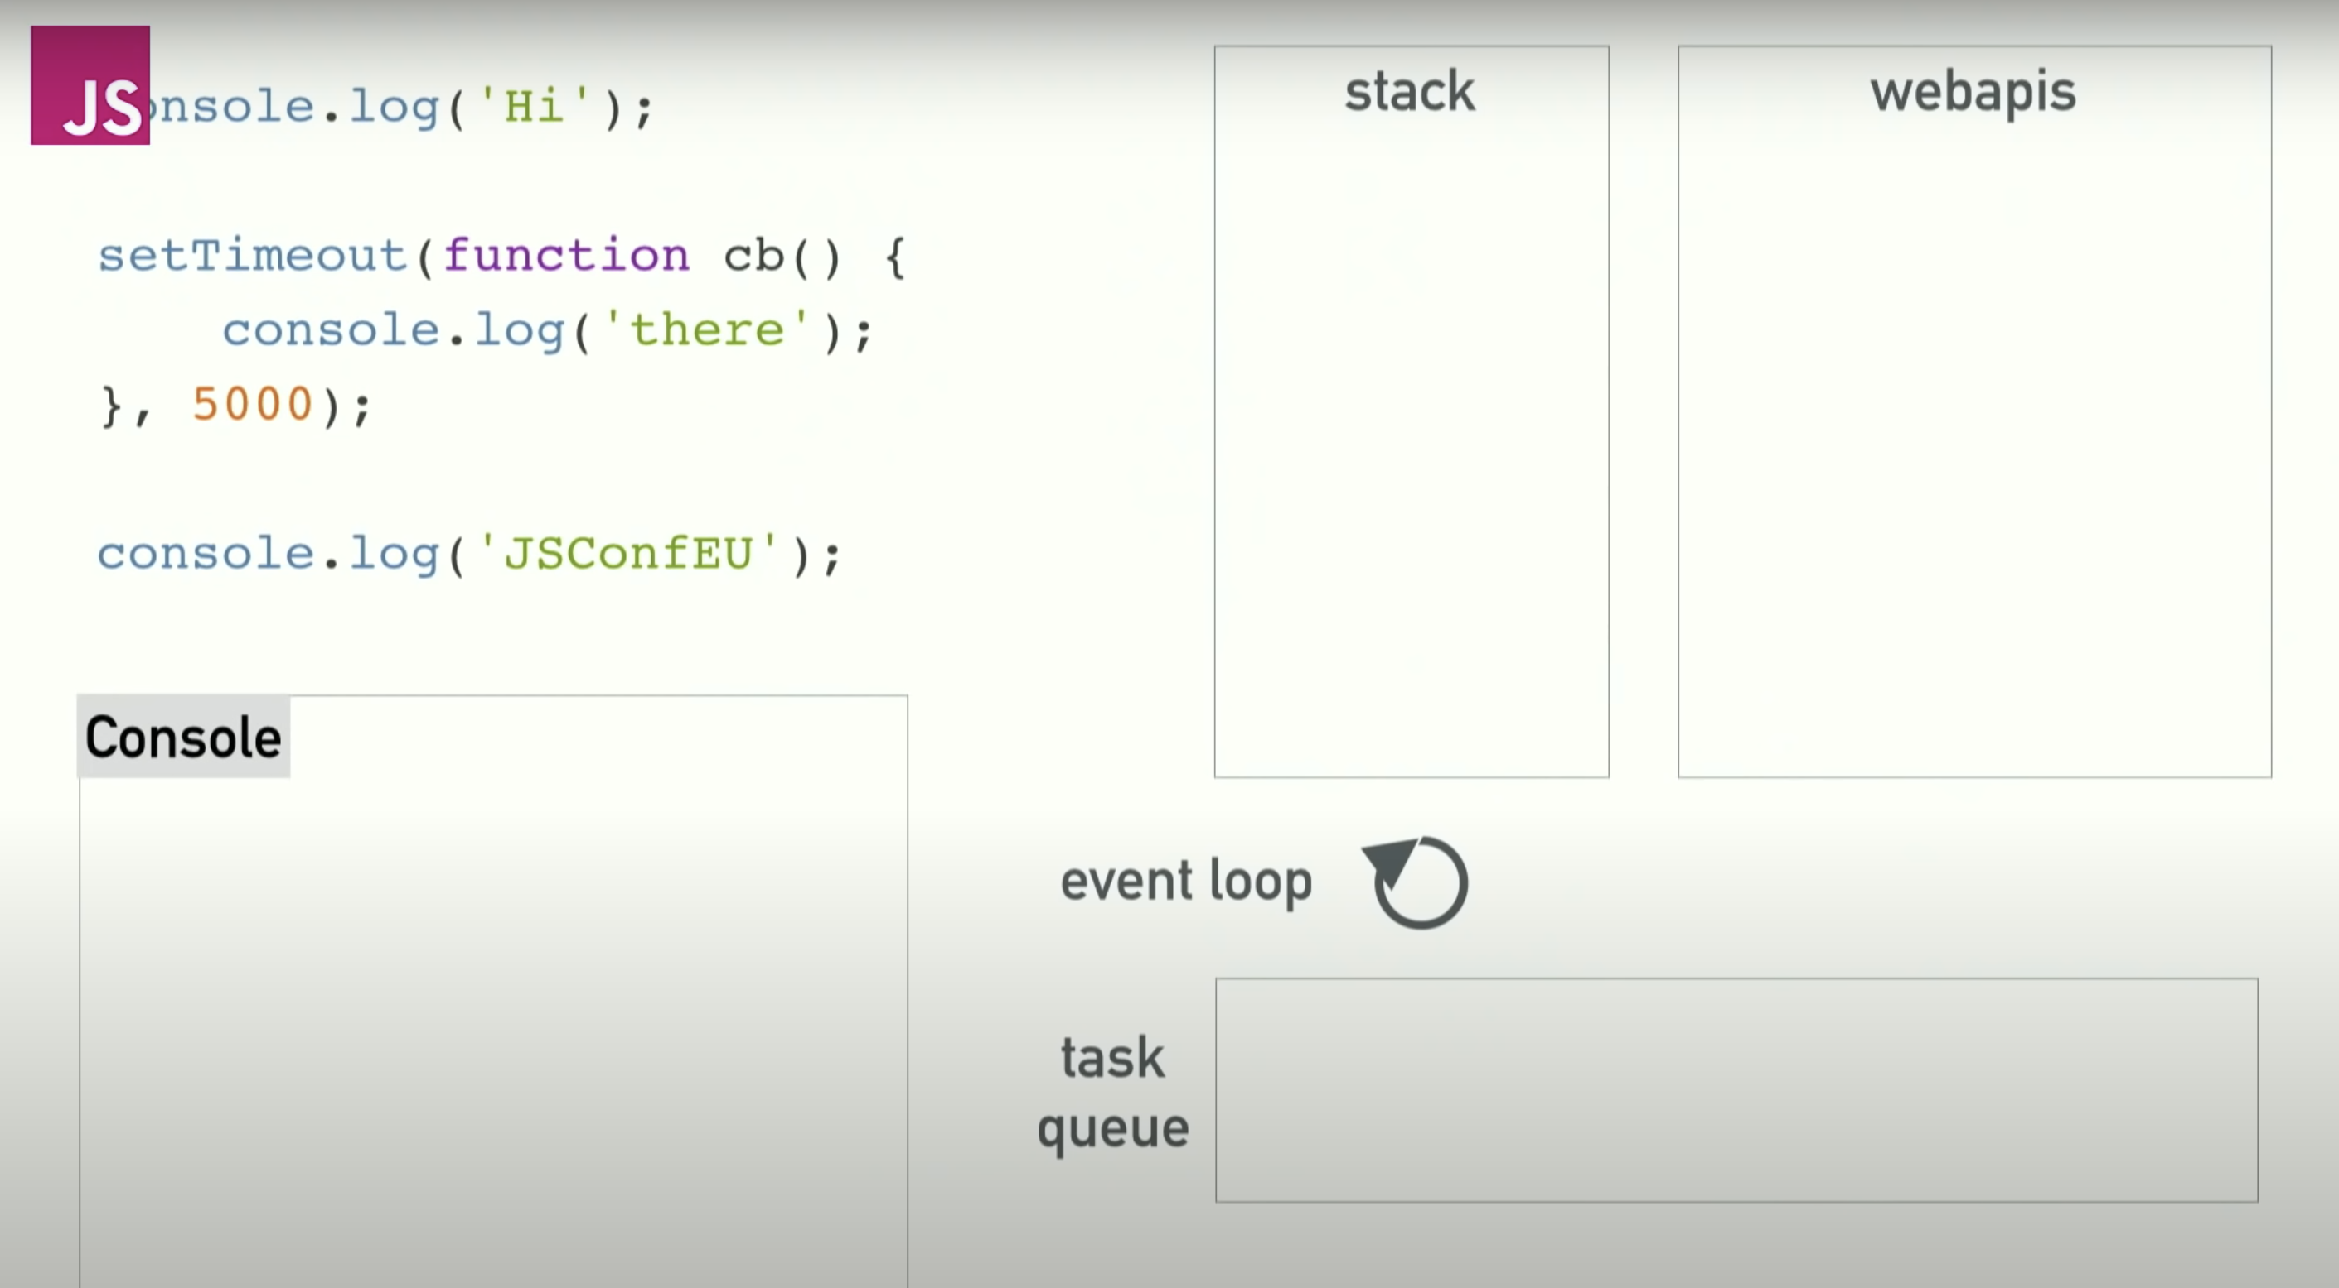
Event Loop

Slide 17
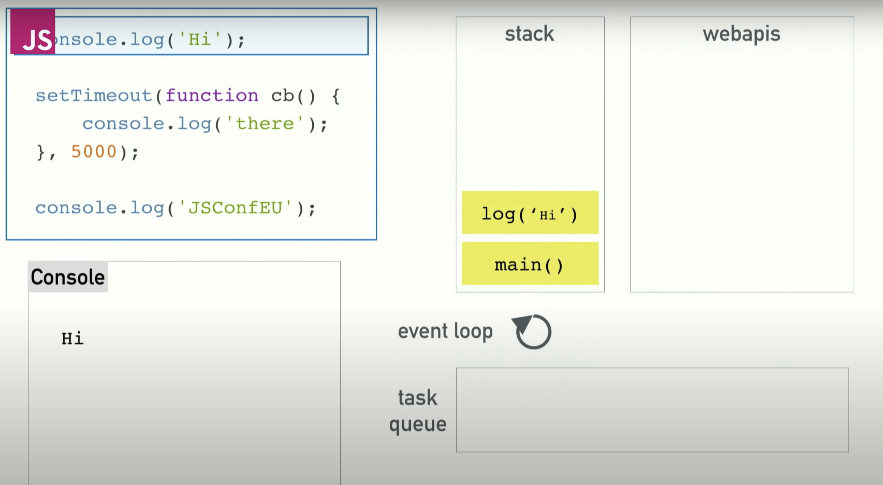
Event Loop

Slide 18
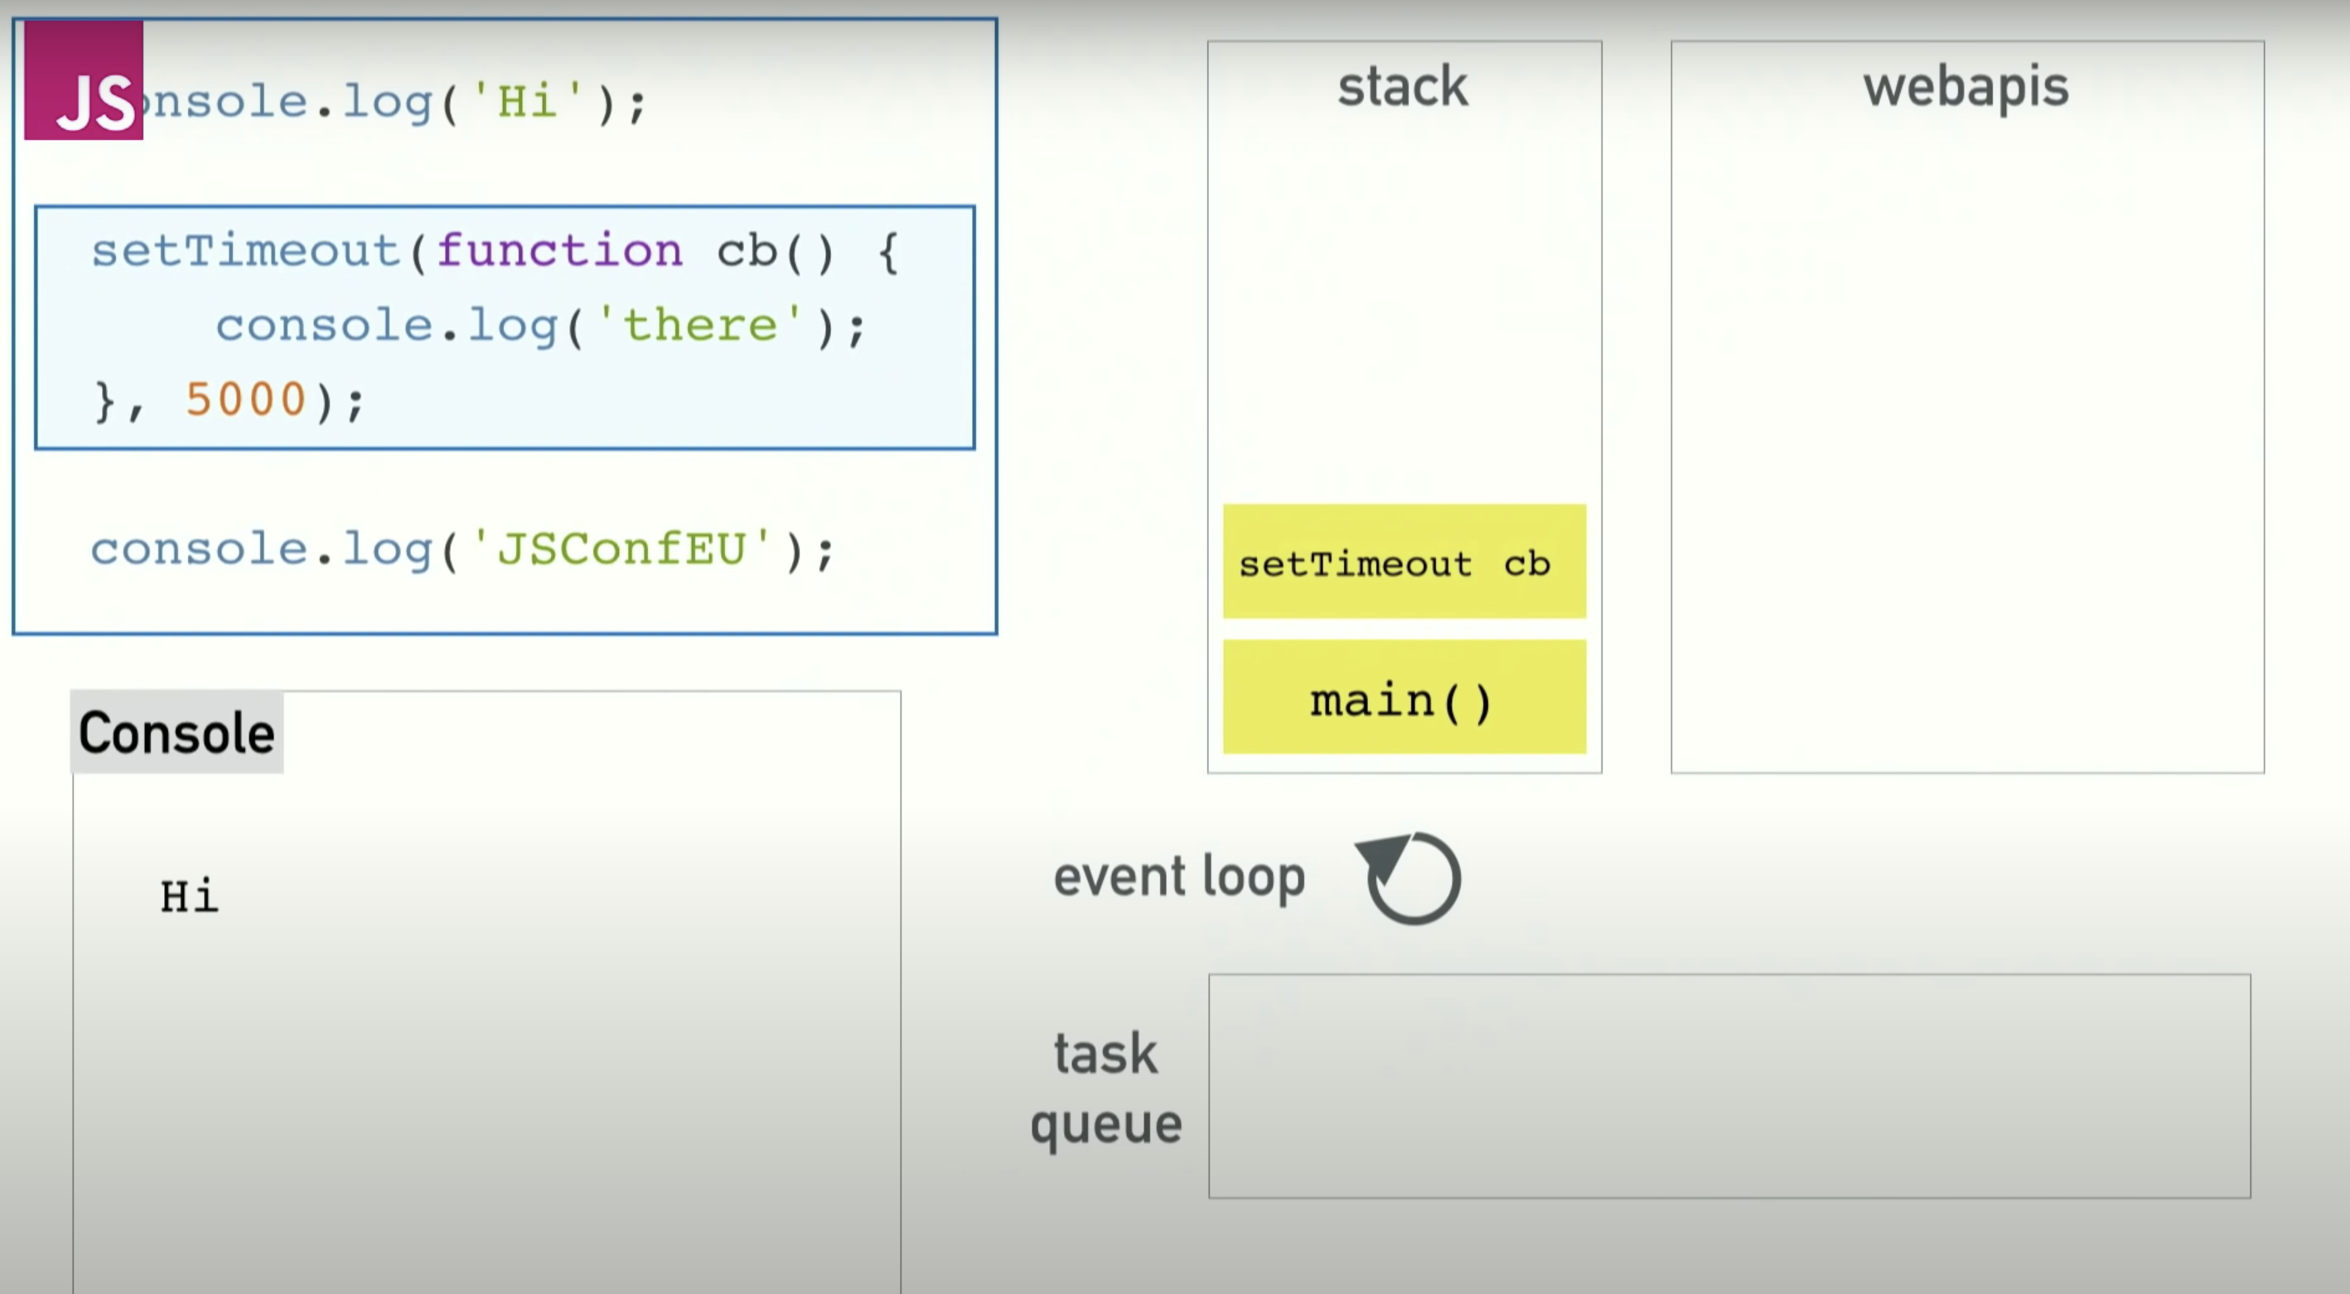
Event Loop

Slide 19
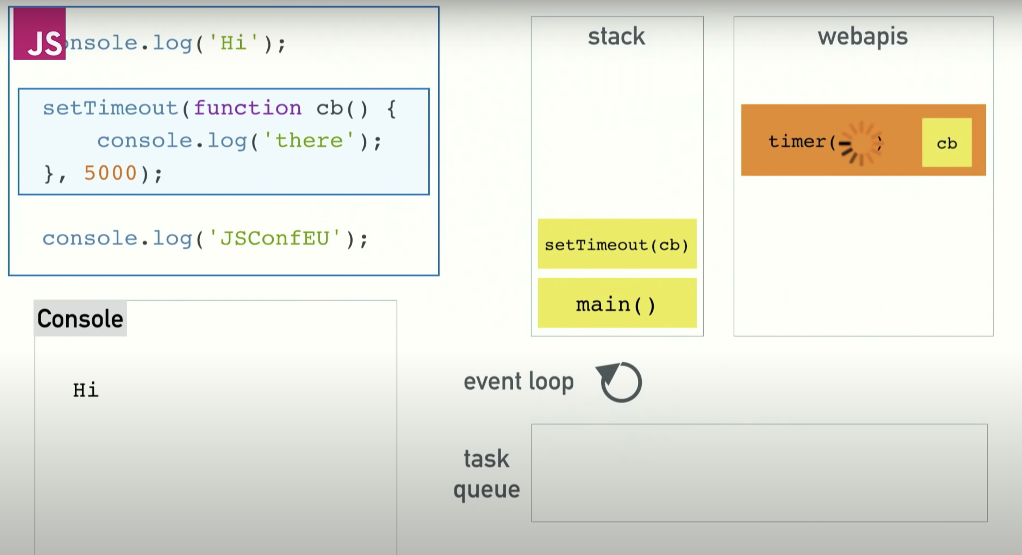
Event Loop

Slide 20
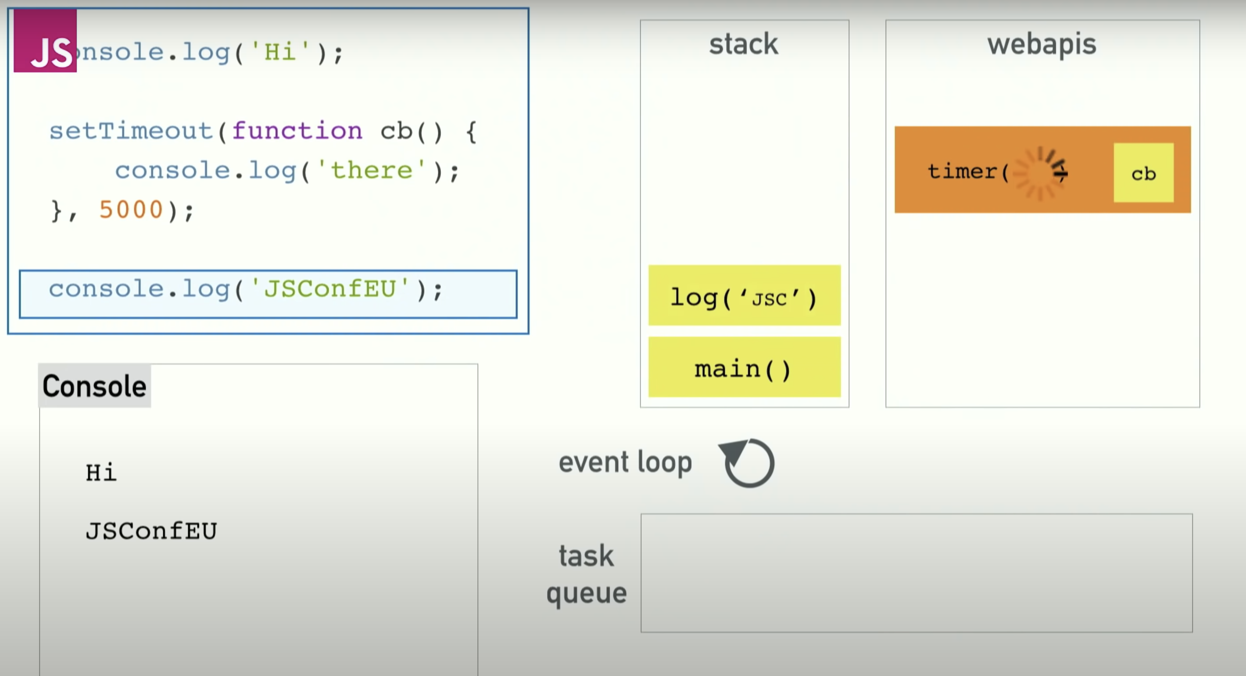
Event Loop

Slide 21
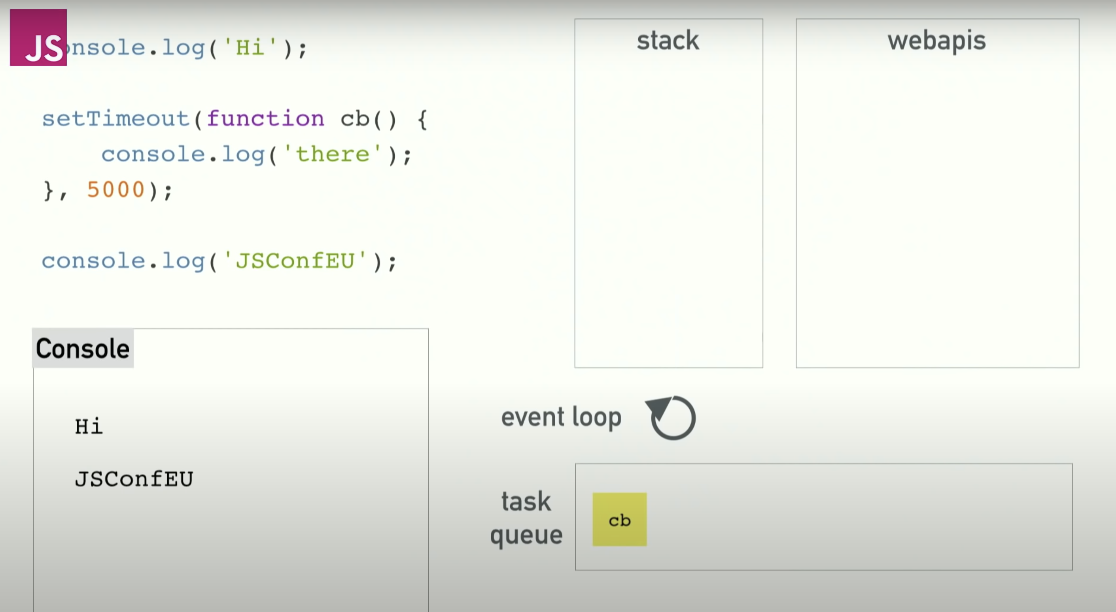
Event Loop

Slide 22
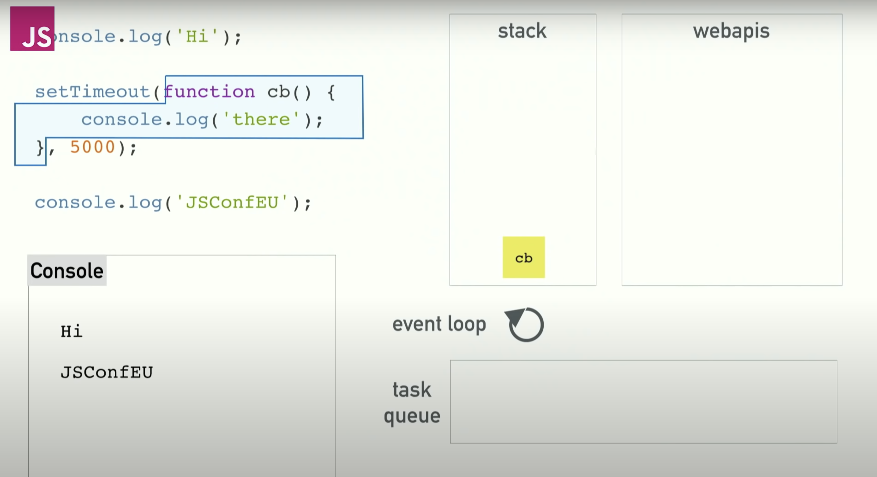
Event Loop

Slide 23
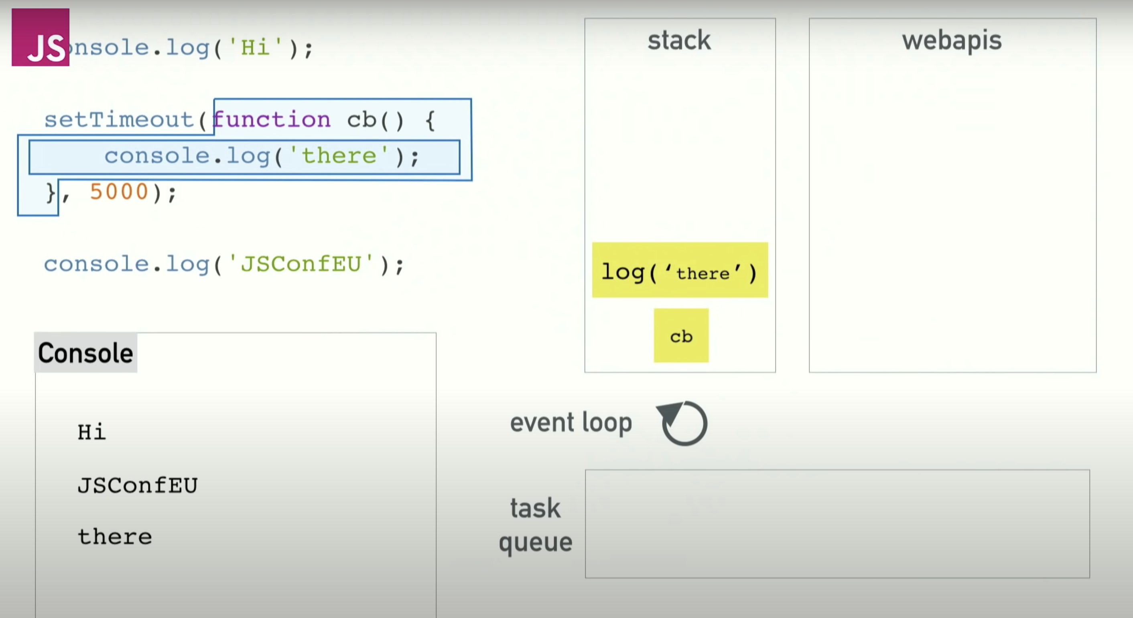
Event Loop

Slide 24

NPM
Node Package Manager
npm is the command line client that allows developers to install and publish those packages.
The npm registry is a public collection of packages of open-source code for Node.js & JS community

Slide 25

Node Installation
https://nodejs.org/en/download/

Slide 26

DEMO
Node CMD
Node-Express setup
Nodemon
Routes
Body Parser
Static assets
Express Handlebars

Slide 27
Questions?

Slide 28

Thank You
Workshop Resources

